Slide 1
Wall Avoiding Microcar

Slide 2
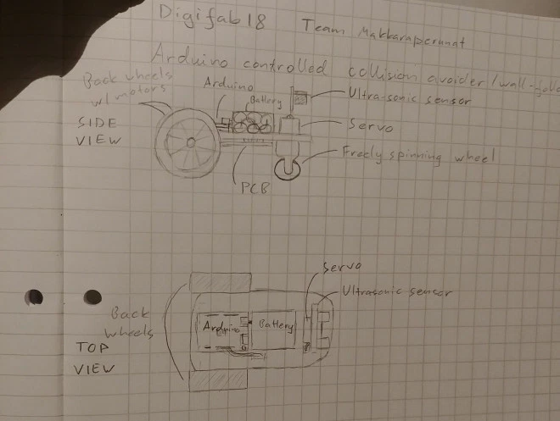
Initial concept and design
Wall Avoiding Microcar
1 spinning servo
1 ultrasonic sensor
2 wheels with dc motors
1 free spinning wheel

Slide 3
Current State
DONE
Wheels 3d printed
Wooden case laser cut and assembled
Documentation 80% done
Coding 90% done
PCB milled / components soldered
TODO
Improve the PCB design
Mill a new board
Improve the soldering of the components ( no short circuits)
Complete the code
Complete the documentation

Slide 5
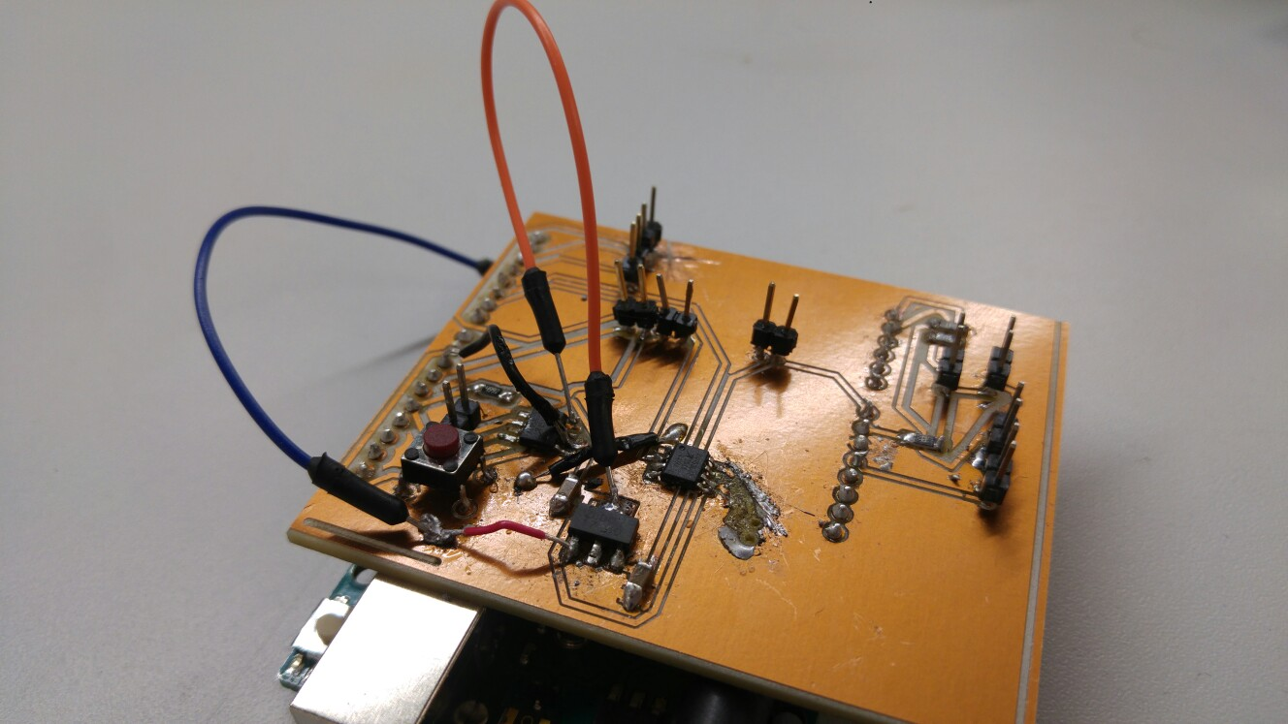

Slide 6
